Slide 1


Slide 2



Finances – three ways to pay
1
Taxpayer assistance
Differences between Medicare and Medicaid
Requires spending down assets and/or income to qualify
2
Traditional LTC insurance
Transferring risk to an insurance company is appropriate
Many have not purchased for many reasons
3
Pay out of pocket
Self-funding
Income
Retirement assets
Cash
Notes:
Unfortunately, long-term care is not free. Actually, it is quite expensive. We typically get three answers: we get the government will pay for me and I mentioned earlier what it will require for the government to pay. That is usually a last resort for most. Also, many believe Medicare pays for this. This can be confusing because Medicare DOES pay for nursing home, however, it is following a hospital stay and only for a short period of time.
It is also designed to be rehabilitative care meaning you are getting better and coming back out. Such as if I had knee replacement or a hip surgery and needed to rehabilitate to be able to take care of myself. The type of care we are talking about today is different. It will require care from this point forward (meaning I am not getting better) and needing help with activities of daily life such as bathing, maintaining continence, dressing yourself, eating/feeding yourself, toileting (including getting on and off a toilet) and transferring (for example, from a bed to a chair).
Medicaid pays for this, but only if you have limited income and resources. Besides, most of Medicaid will not pay for care at home. It most likely will require facility care….most people we work with want to stay in the comfort of their own home without restricted visiting hours for their friends and family or being potentially exposed to other illnesses.
The second answer we get is traditional type LTC insurance and that is absolutely appropriate! I applaud anyone who has put this protection in place. However, most have not because it can be expensive, the premiums can increase over time, but the biggest thing we have heard is that “it is a use it or lose it” policy. Meaning if I don’t need care, all the money I paid in is now gone.
The third response we get is “I will pay for this out of my own money”.

Slide 3


Impact on Finances
Income
Not a one-time payment
New monthly bill (expense) without an end date
Stop paying other obligations to afford this new expense?
Income to fill gap between current income and income need?
Assets
Many believe they have “plenty” of assets.
Liquidate faster than intended; sell at inopportune time
Ripple effect on other planning;
Spouse retirement lifestyle
Children inheritance
Higher withdrawal rate
Higher Medicare premiums
Not efficient use of tax incentives to leverage own assets
Long-term care is an income problem; not an asset problem.
Notes:
Most believe or have been told that they have “plenty of assets”. This may be true! However, there may be a better way to pay out of assets. Also, needing care isn’t a one-time payment at a set price. It is an increased expense in your retirement years that will require more income to pay. Are your assets able to suddenly generate this increased need for income at the exact moment you need it?
Long term care is an income or cash flow problem, not an asset problem.

Slide 4

Tax-free money to help cover expenses
HIPAA Law of 1996
Gives tax-free use of life insurance death benefit to be used while living for qualifying long-term care expenses.
Pension Protection Act of 2006
Extends the HIPAA Law to certain annuities to be used for long-term care expenses tax-free.
Provided content is for overview and informational purposes only and is not intended as tax, legal, fiduciary, or investment advice.
This Photo by Unknown Author is licensed under CC BY-SA
Notes:
The government recognized that there were a lot of people that this would affect. Many would spend down their money to eventually end up on taxpayer assistance anyway.
So they said, “why are we waiting for this to happen? Let’s give them tax incentives NOW to encourage them to plan for later.” That is how they influence behavior, right? They raise taxes to keep us from doing things and lower them to encourage us to do things and it works very well!
The first tax law passed is to allow the use of life insurance tax free to pay these care expense bills via the HIPAA Law of 1996.
Now, when I say life insurance, most will say “my kids are grown and my house is paid for, why do I need life insurance?” What most fail to realize is that life insurance is one of the last buckets that are chuck full of tax incentives that we all love — tax deferral in cash value growth,
larger amount tax free at death to my heirs, and now they blessed certain life policies with one more tax blessing — tax free while they are alive to pay for these care expense bills.
So don’t view this as you normally would view life insurance, but view this as a tax vessel that the government is using to deliver tax free money to you for this expense.
The second tax law was passed 10 years later. The Pension Protection Act extended the HIPAA Law to certain annuities to be used tax free for long-term care bills as well!

Slide 5
How asset-based LTC works
1st day of care
Life insurance death benefit exhausted.
Rider begins LTC payments.
Base policy
Rider – Lifetime
Life insurance or annuity
Funding options:
Cash lump sum
Annual premiums
Nonqualified annuities
Qualified money
Cash value life insurance
Rider (continuation of benefits)
Funding options:
Cash single premium
Fixed annual premium
Notes:
We rarely get asked, “how does this work if I die?”. Most people understand how life insurance and annuities work when someone passes away. However, we usually get asked, “How does this work if I need it for my care?”
This diagram helps explain how the concept works!
We call this our “Timeline.” To the left is day one and will begin with either a life insurance policy or an annuity first. We call this the “Base Policy.” Once the base policy is exhausted, the “Rider” kicks in and keeps paying the amount for an extended period, up to your lifetime.
You may fund the life policy via cash, CDs, savings, life insurance cash values, and qualified retirement money! There are also payment options available for those using an income stream to pay rather than an asset reposition. The annuity options use either qualified or non-qualified money. The rider may be funded by single premium or fixed annual premiums. These premiums are guaranteed to never increase and have tax incentives.

Slide 6

Consider your situation
If any of these situations resonate with you, repurposing a portion of your qualified assets into Care Solutions products may be a helpful strategy for you.
You have excess qualified dollars that you don’t need for retirement income.
You’ve inherited wealth from a loved one.
You have a desire to pass assets to future generations.
You are considering a Roth conversion.
You are concerned about future needs for extended care.
Notes:
Consider your situation. Do any of these apply to you?

Slide 7


Slide 8
Concept of asset-based LTC
Typical portfolio assets position:
Aggressive — significant growth with the acceptance of the risk of loss of principal
Moderate — some growth with the acceptance of some downside risk
Conservative — conservation of principal — often with guarantees
Moderate
LIFETIME
to pay for the entire
length of care
$$
$$$
Aggressive
Conservative
Typical portfolio assets position:
Aggressive — significant growth with the acceptance of the risk of loss of principal
Moderate — some growth with the acceptance of some downside risk
Conservative — conservation of principal — often with guarantees
CASH VALUE - DEATH BENEFIT - LTC INCOME
Notes:
So, how do we create this income stream to fill the “gap”?
If you were to self-fund, this is an example of an option that may work for you. This is the concept of asset-based LTC.
If a portfolio has moderate, conservative, or aggressive type assets, most will prefer to use their conservative assets first in the event of needing LTC.
If you’re going to to use this money, why not carve out a piece, reposition it from one pocket to the other to take advantage of the tax incentives like the HIPAA law or the Pension Protection Act? By repositioning these assets and purchasing asset-based protection with lifetime coverage, you are turning this into an unlimited bucket of income specifically designed to pay care expense bills when they come in. By doing this, you can leave the rest of your portfolio intact.
By using this option, you could reposition an amount into a specific policy that is designed to provide a stream of money to pay LTC expenses to help avoid pulling the money directly out of other investments. Lifetime coverage is the ONLY option to help cover the entire length of an extended care need due to illnesses such as Alzheimer’s, Parkinson’s, and Dementia.

Slide 9
Repurposing qualified retirement assets
What are
Qualified Assets?
Tax Attributes of Qualified Money
Income Tax
With qualified plans, you set aside part of your pay before federal and state income taxes are withheld, lowering your taxable income during your working years.
You will be taxed on the money you take from qualified accounts when you begin to take distributions.
Required Minimum Distributions (RMDs)
You cannot keep retirement funds in your account(s) indefinitely. At some point, you will be forced to take RMDs at a designated age. Simply put, there is no way to avoid taxes on these distributions, and future tax rates can be unpredictable.
Your RMDs are minimum amounts that U.S. tax law requires to be withdrawn annually from traditional IRAs and employer-sponsored retirement plans (qualified accounts). Based on the Secure 2.0 Act of 2022, RMD distributions vary based on the individual’s date of birth, falling somewhere between age 70 ½ and 75.
Qualified assets are found in retirement accounts, such as IRAs, 401(k)s, and 403(b)s.
Qualified money receives tax advantages that nonqualified money does not. The core advantage of these accounts is the ability to fund them with pre-tax earnings.
NOTE: This example assumes qualified funds. Non-qualified funds can also be used for Care Solutions products. Provided content is for overview and informational purposes only and is not intended as tax, legal, fiduciary, or investment advice.
Notes:
Read slide

Slide 10
Repurposing qualified retirement assets
1
Assess your portfolio
How much do you want to repurpose?
2
25% Premium Bonus
Qualified Asset
Portfolio
$150,000
Care Solutions products can provide you with a 25% automatic premium bonus which provides additional purchasing power to obtain LTC protection.
Premium Bonus
$37,500
Repurposed Asset
$187,499
3
Repurposed Asset
Repurposed asset pays for your policy
Spread out tax liability with
10 annual distributions of $18,750
All numeric examples listed are hypothetical and provided for explanatory purposes only.
Notes:
An option would be to identify which qualified asset, when repositioning to a different annuity, a premium bonus is added to the asset balance. The total amount is larger due to the bonus. Ten equal distributions will be made which allows the tax liability that is owed to be spread out over 10 years. This annual amount is the how the premium for the LTC policy is calculated.

Slide 11
Funding with retirement dollars
Qualified asset Premium bonus Repurposed asset
[$150,000] [$37,500] [$187,499]
Hypothetical example:
Male, age 60
Female, age 60
Base policy – 24 mos.
Rider – Lifetime
[$18,750] | Premium – 10 pay annually
[$83,208] | Annual LTC Benefit - each
[$6,934] | Monthly LTC Benefit - each
[$166,415] | Death Benefit
included | Premium – 10 pay annually
[$83,208] | Annual LTC Benefit - each
[$6,934] | Monthly LTC Benefit - each
[55%] | Rate equivalent to another investment
CASH VALUE - DEATH BENEFIT - LTC INCOME
All numeric examples listed are hypothetical and provided for explanatory purposes only.
Notes:
Talk through example

Slide 12
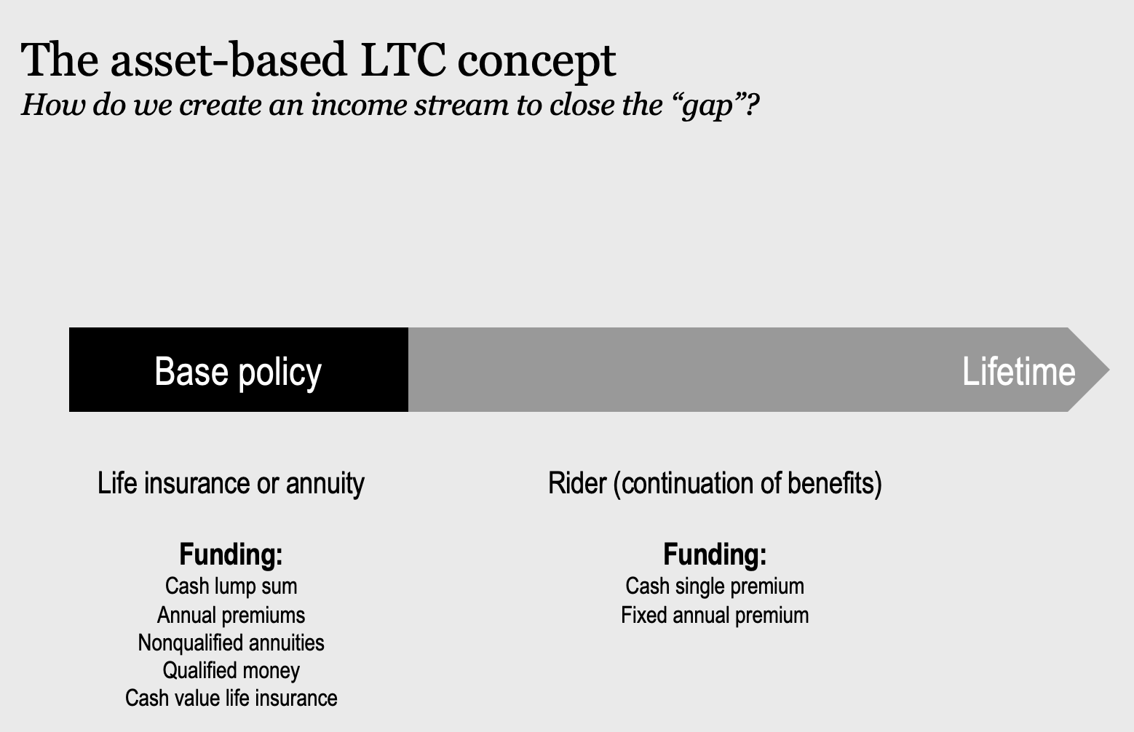

Slide 13
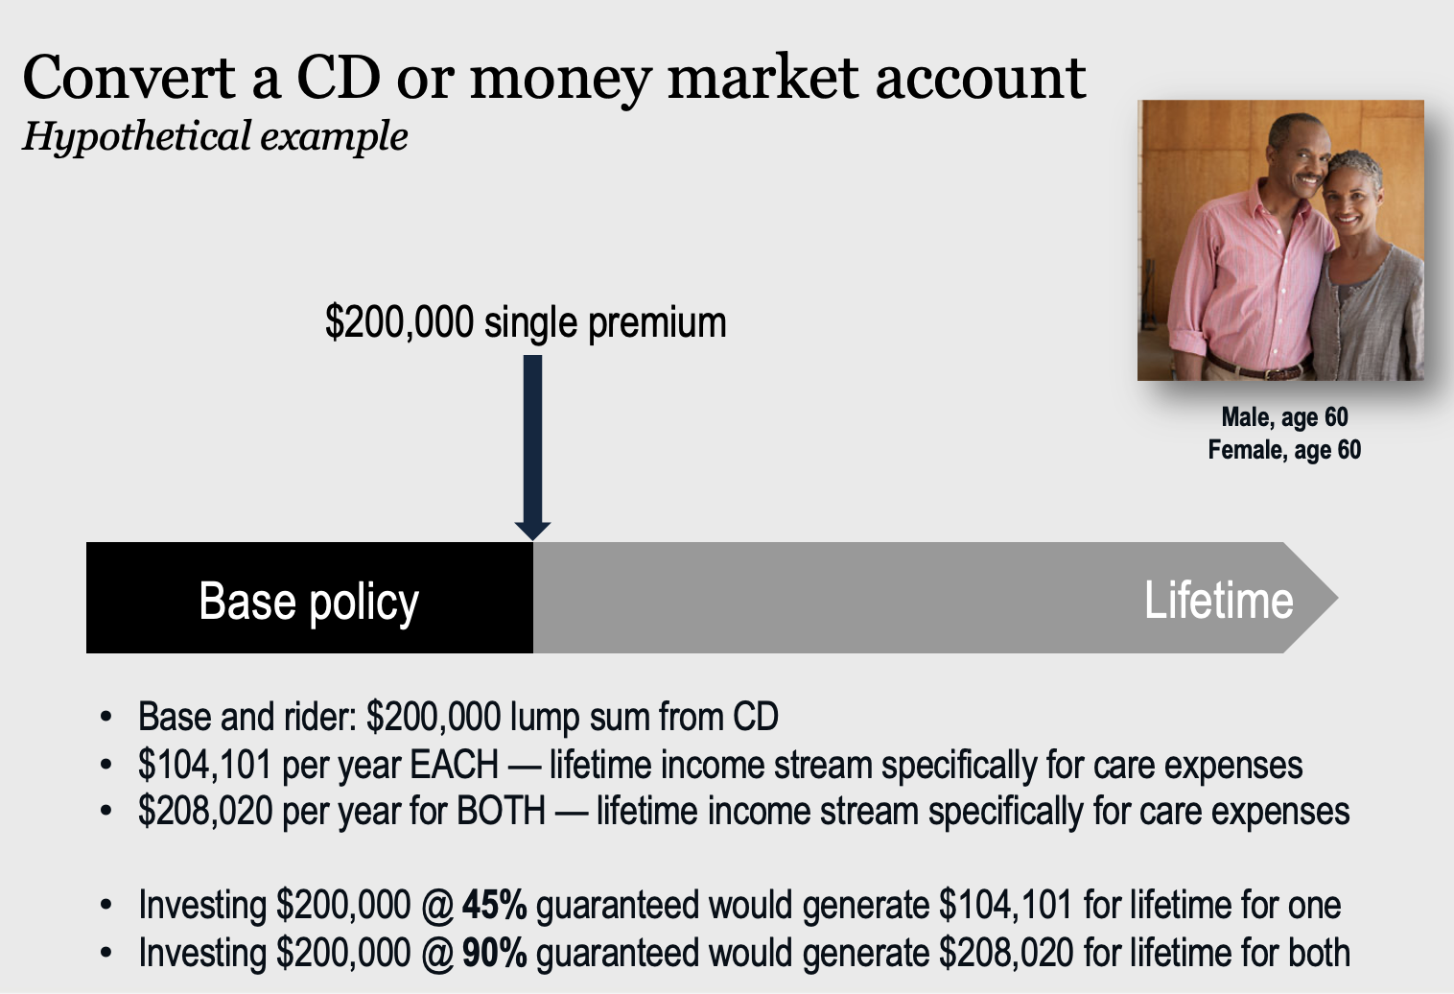

Slide 14
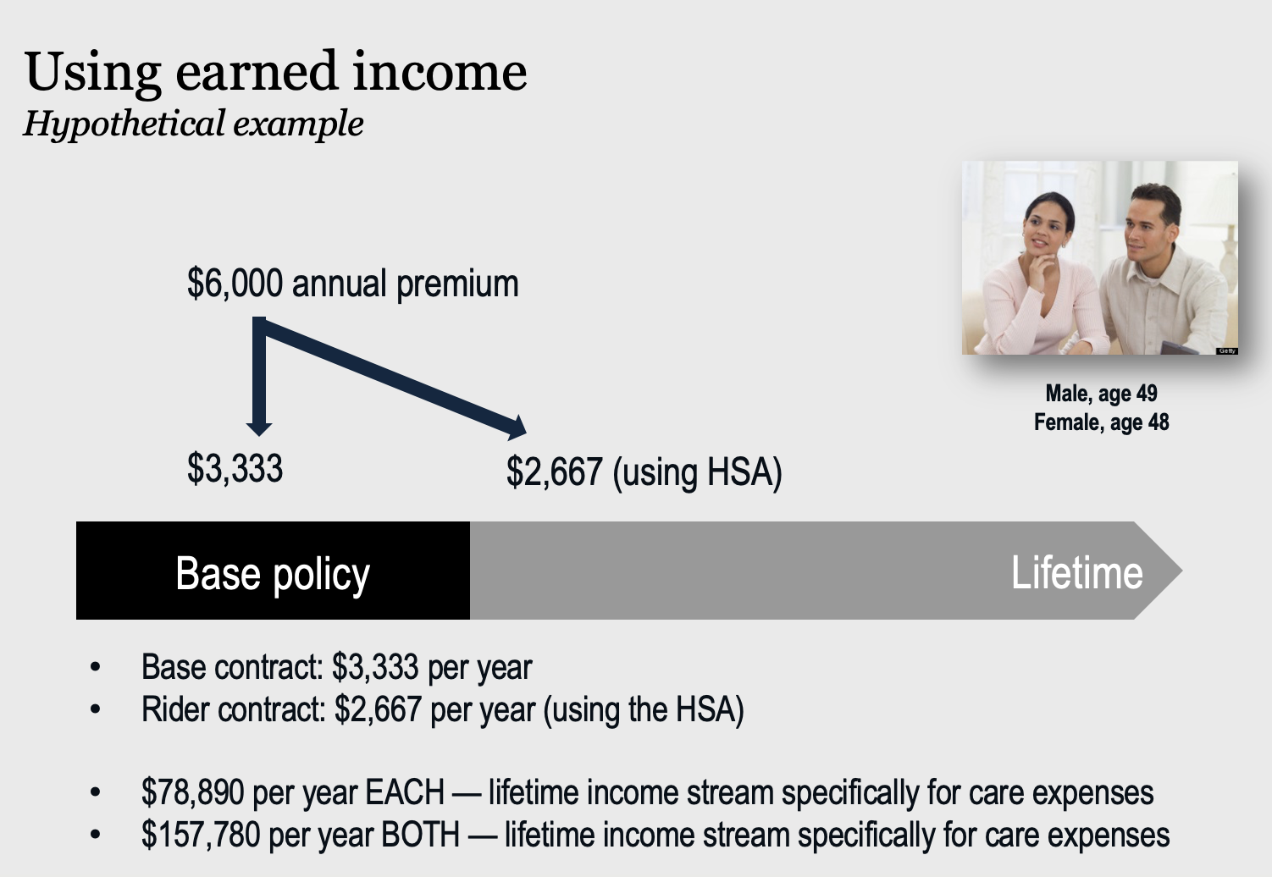

Slide 15
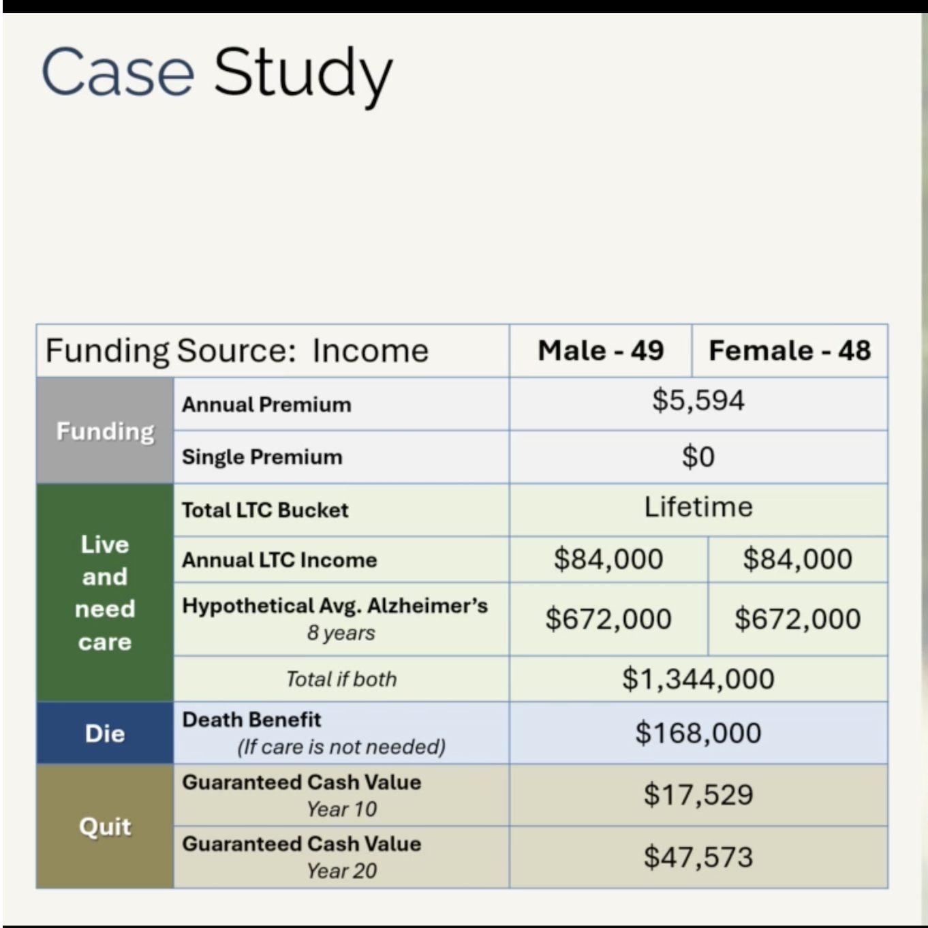

Slide 16
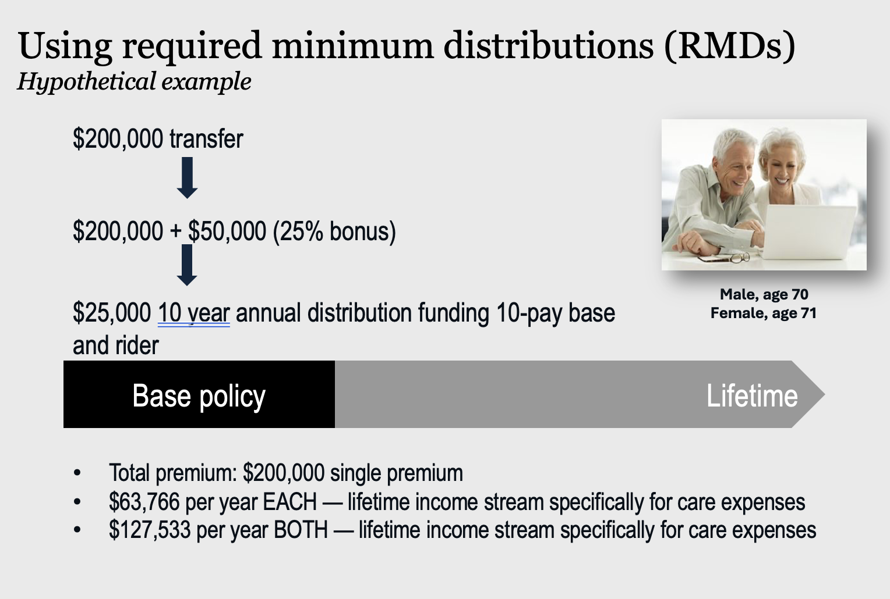

Slide 17
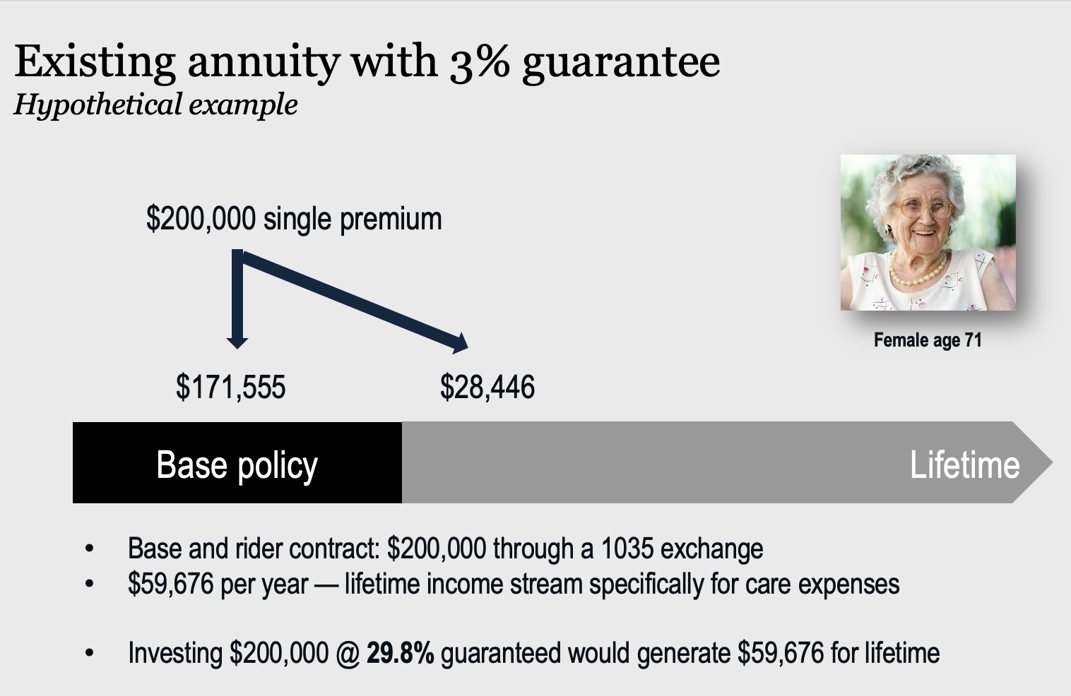

Slide 18




The Stacking Strategy
Hypothetical example
Male, age 40
Female, age 40
Age 55
TOTAL
Death
Benefit:
$50,000
Annual
Premium:
$2,345
Annual
Lifetime LTC:
$24,996
Annual
Premium:
$1,873
Death Benefit: $200,000
Annual Premium
$7,076
Annual LTC Income
$99,984
Age 50
Death
Benefit:
$50,000
Annual
Lifetime LTC:
$24,996
Annual
Premium:
$1,547
Age 45
Death
Benefit:
$50,000
Annual
Lifetime LTC:
$24,996
Age 40
Death
Benefit:
$50,000
Annual
Premium:
$1,311
Annual
Lifetime LTC:
$24,996
All numeric examples listed are hypothetical and provided for explanatory purposes only.
Notes:
The strategy we’ll be taking with these clients is a stacking approach.
If you think about how most people have bought life insurance over the years, a lot have bought 2 to 6 policies over time and stacked the benefits.
They’ve usually done it for one of two reasons, affordability or changes in needs. When you’re in your 20s or 30s it may not be in the budget or necessary to buy $500k+ of life insurance death benefit.
So, you might buy a term policy with a $100k death benefit or less at first and slowly over time convert the term policy and add on additional policies and riders as you can afford it and as your needs change to get to that desired amount of protection.
We can take this same stacking approach for long-term care protection with our younger clients. Purchase what is affordable when you can and add additional policies over time.

Slide 19


Slide 20
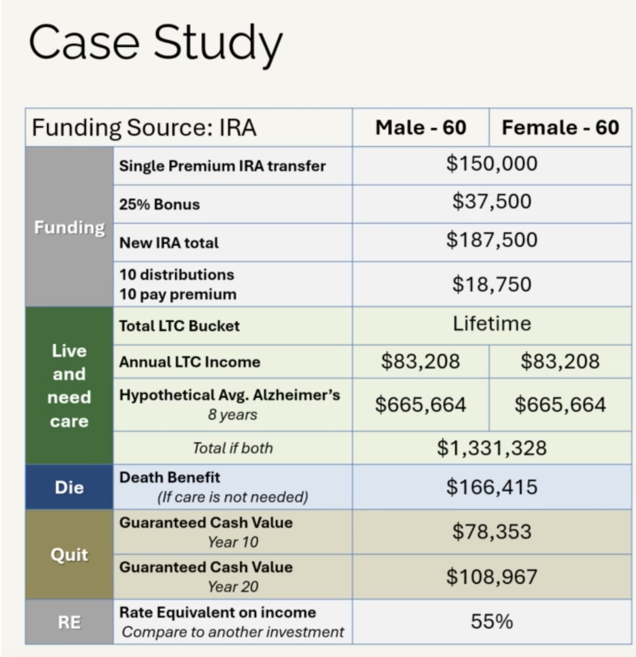

Slide 21
Funding with existing annuity
Repurposed Annuity Asset into fixed annuity
[$200,000]
Hypothetical example:
Female, age 71
Base annuity – 36 mos.
Rider – Lifetime
[$154,356] | Premium
[$55,812] | Annual LTC Benefit
[$4,651] | Monthly LTC Benefit
$$$ | Annuity value at death
[$45,652] | Premium
[$55,812] | Annual LTC Benefit
[$4,651] | Monthly LTC Benefit
[28%] | Rate equivalent to another investment
All numeric examples listed are hypothetical and provided for explanatory purposes only.
Notes:
Talk through example

Slide 22
Funding with existing annuity
Repurposed Annuity Asset into fixed annuity
[$200,000]
Hypothetical example:
Male, age 63
Base annuity – 24 mos.
Rider – 72 mos.
[$200,000] | Premium
[$99,996] | Annual LTC Benefit
[$8,333] | Monthly LTC Benefit
[$200,000] | LTC Benefit balance
included | Premium
[$99,996] | Annual LTC Benefit
[$8,333] | Monthly LTC Benefit
[$600,000] | Rider benefit balance
Total: 96 months (8 years) = $800,000
All numeric examples listed are hypothetical and provided for explanatory purposes only.
Notes:
Talk through example

Slide 23
Funding with existing annuity
Repurposed Annuity Asset into an annuity
[$150,000]
Hypothetical example:
Female, age 71
Base annuity – 24 mos.
Rider – Lifetime
[$145,398] | Premium
[$73,920] | Annual LTC Benefit
[$6,160] | Monthly LTC Benefit
$$$ | Annuity value at death
[$4,602] | Premium – annual guaranteed
[$73,920] | Annual LTC Benefit lifetime
[$6,160] | Monthly LTC Benefit lifetime
All numeric examples listed are hypothetical and provided for explanatory purposes only.
Notes:
Talk through example

Slide 24


Slide 25


